Slide 1
MongoDB Regular Expression (Regex) with Examples
Group 12
Feiyao Li & Tianya Zhang

Slide 2
Outline
Introduction
Using $regex operator for Pattern matching
Pattern Matching with $options
Pattern matching without the regex operator
Fetching last 'n' documents from a collection
Summary

Slide 3
Introduction
Regular expressions are used for pattern matching, which is basically for findings strings within documents.
Sometimes when retrieving documents in a collection, you may not know exactly what the exact Field value to search for. Hence, one can use regular expressions to assist in retrieving data based on pattern matching search values.

Slide 4
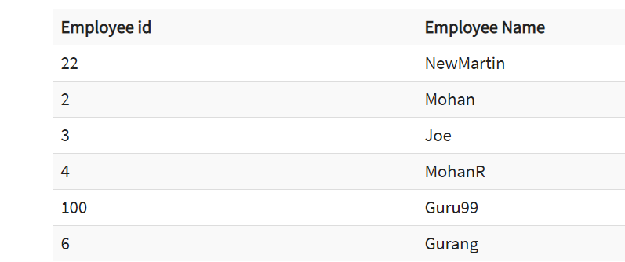
Using $regex operator for Pattern matching
The regex operator in MongoDB is used to search for specific strings in the collection. The following example shows how this can be done.

Slide 5
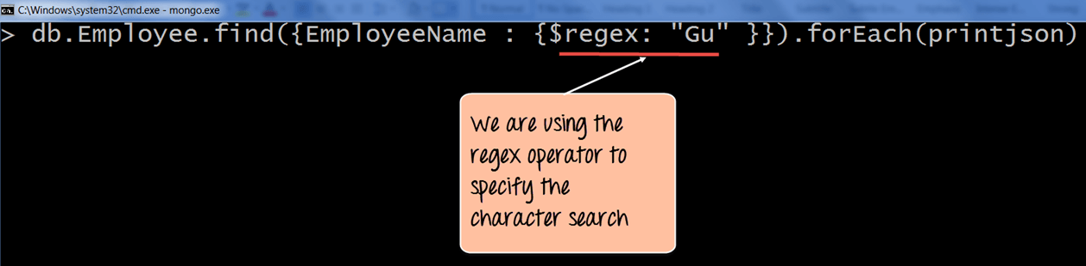
Using $regex operator for Pattern matching
Here in the below code we have used regex operator to specify the search criteria.
Code Explanation:
1. Here we want to find all Employee Names which have the characters 'Gu' in it. Hence, we specify the $regex operator to define the search criteria of 'Gu’.
2. The printjson is being used to print each document which is returned by the query in a better way.

Slide 6
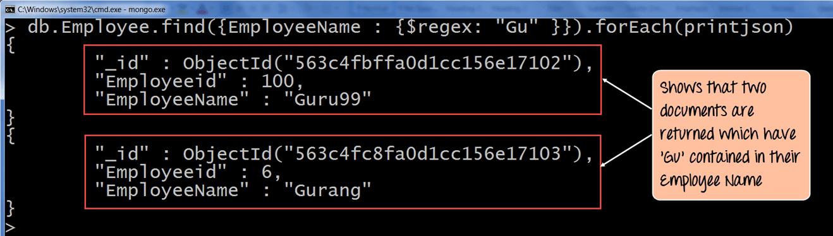
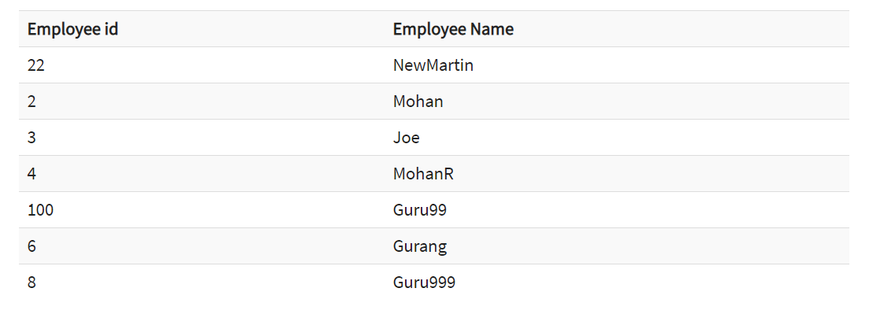
Using $regex operator for Pattern matching
The output clearly shows that those documents wherein the Employee Name contains the 'Gu' characters are returned

Slide 7
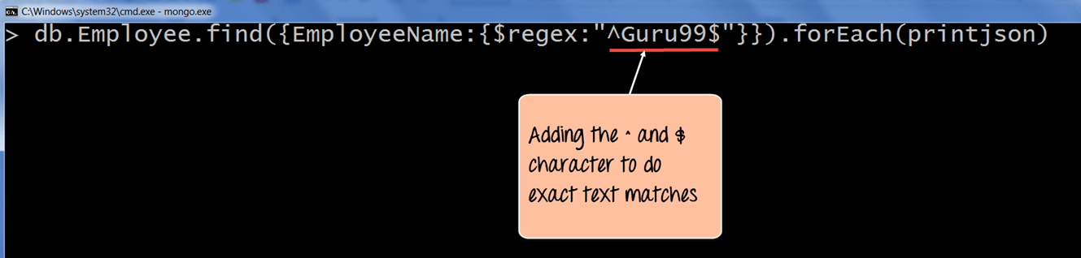
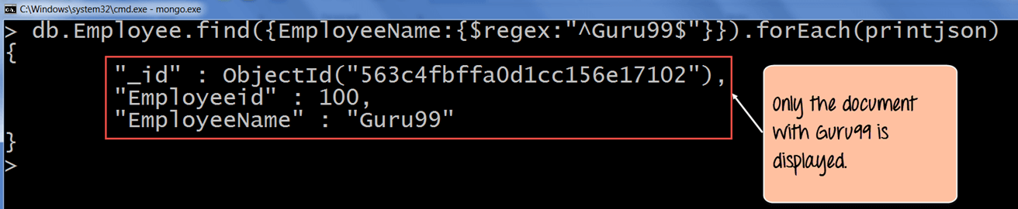
To do an exact pattern matching, we will use the ^ and $ character. We will add the ^ character in the beginning of the string and $ at the end of the string.
The ^ is used to make sure that the string starts with a certain character, and $ is used to ensure that the string ends with a certain character. So when the code executes it will fetch only the string with the name "Guru99".

Slide 8
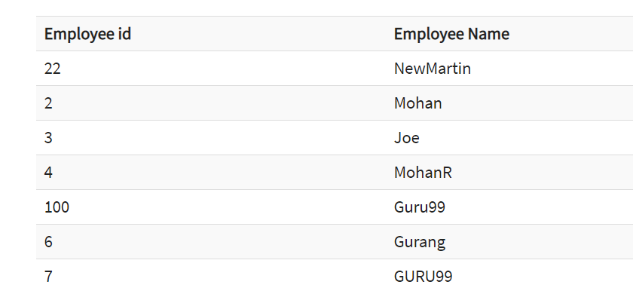
Pattern Matching with $options
When using the regex operator one can also provide additional options by using the $options keyword.
For example, suppose you wanted to find all the documents which had 'Gu' in their Employee Name, irrespective of whether it was case sensitive or insensitive. We need to use the $options with case insensitivity parameter.

Slide 9
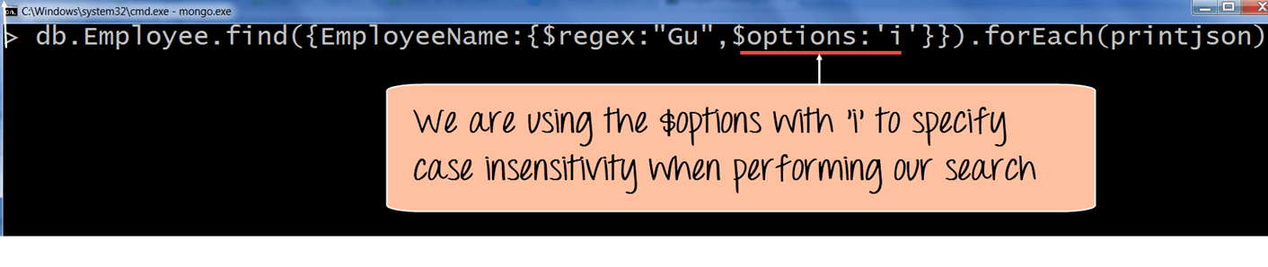
Pattern Matching with $options
Code Explanation:
The $options with 'I' parameter (which means case insensitivity) specifies that we want to carry out the search no matter if we find the letters 'Gu' in lower or upper case.

Slide 10
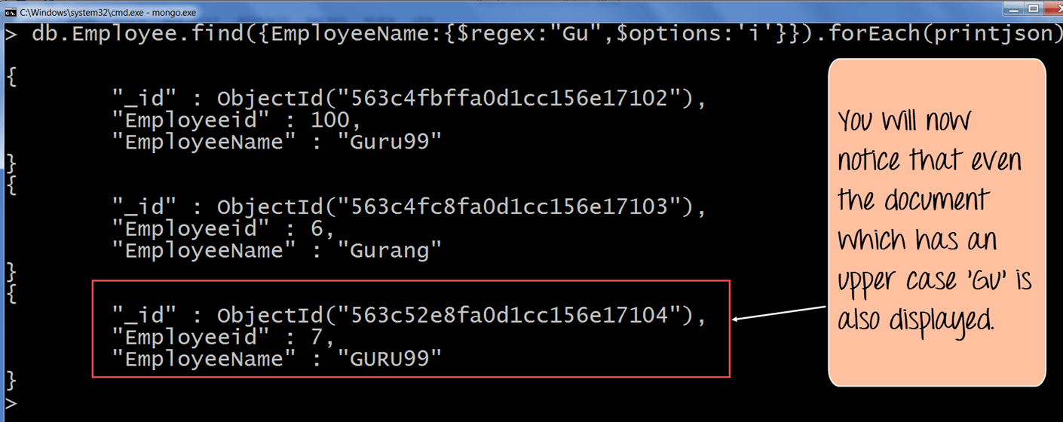
Pattern Matching with $options

Slide 11
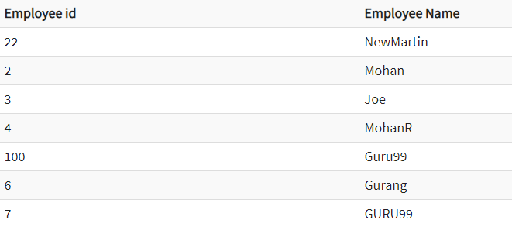
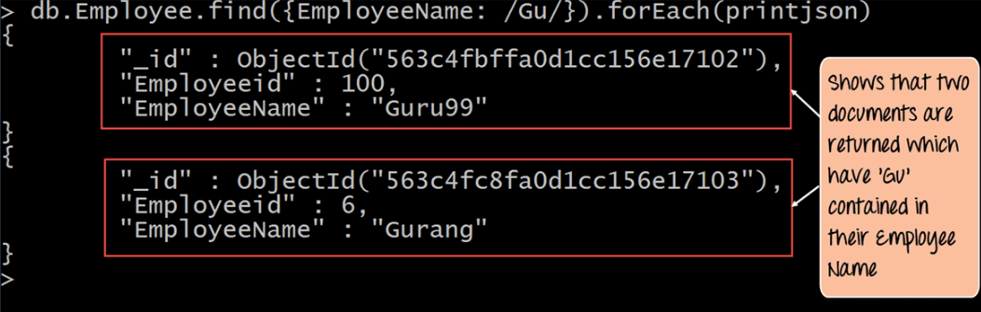
Pattern Matching without regex Operator
Sensitive

Slide 12
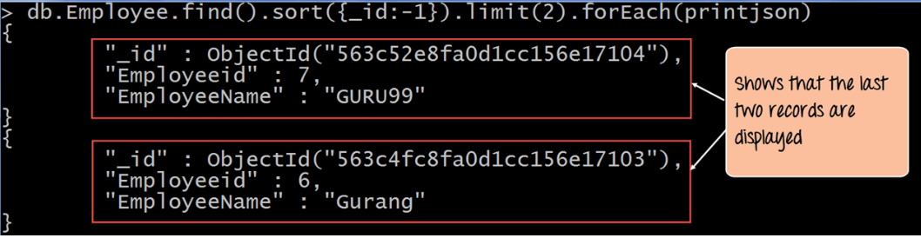
Fetching Last 'n' Documents in a Collection
Descending Order

Slide 13
Summary
Pattern matching can be achieved by the $regex operator. This operator can be used to find for certain strings in the collection.
The ^ and $ symbol can be used for exact text searches with ^ being used to make sure that the string starts with a certain character and $ used to ensure that the string ends with a certain character.
The 'i' along with the $regex operator can be used to specify case insensitivity so that strings can be searched whether they are in lower case or upper case.
The delimiters // can also be used for pattern matching.
Use a combination of sort and the limit function to return the last n documents in the collection. The sort function can be used to return the documents in descending order after which the limit clause can be used to limit the number of documents being returned.

